Slide 1
J2ME :: The Basics
Feb 20 2007

Slide 2
What is J2ME?
Java 2 Micro Edition combines a resource-constrained JVM and a set of Java APIs for developing applications for mobile devices
Different devices have different capabilities; J2ME is a platform described in the form of configurations and profiles

Slide 3
J2ME on Device
Do you, as a developer, have to install this
JVM and the APIs on mobile devices?
No. Device manufacturers install and
prepackage their devices with this JVM (and
associated APIs). You only need to develop
applications targeting these devices and
install them.

Slide 4
J2ME Components
J2ME can be divided into three parts: a configuration, a profile, and optional packages.
A configuration contains a constrained JVM and some class libraries.
A profile builds on top of these base class libraries by providing a useful set of APIs and optional packages. Optional packages are traditionally not packaged by the device manufacturers, and you have to package and distribute them with your application.
The configuration and profile are supplied by the device manufacturers and they embedded them in the devices.

Slide 5
J2ME Stack
Optional Packages
e.g. mobile media API, 3D graphics
Profile
e.g. MIDP, foundation profile
Configuration
e.g. CLDC, CDC
JVM

Slide 6
Popular Configuration and Profile
Most popular configuration that Sun provides is Connected Limited Device Configuration (CLDC). The JVM that it provides is very limited and supports only a small number of traditional Java classes. Its counterpart, the Connected Device Configuration (CDC) is for devices with at least 2MB of memory available and supports a more feature-rich JVM (but still not a standard JVM).
Most popular profile that Sun provides is the Mobile Information Device Profile (MIDP). This profile complements the CLDC configuration very well because it minimizes both the memory and power required for limited devices. It provides the basic API that is used for creating application for these devices. For example, it provides the javax.microedition.lcdui package that allows us to create the GUI elements that can be shown on a (limited) device running the MID profile on top of a CLDC configuration. Note that MIDP cannot be used with CDC devices. CDC devices get their own set of profiles, like the Foundation and Personal profiles.
However, I will not cover these profiles or the CDC here, but will focus on using MIDP and CLDC only.

Slide 7
CLDC
CLDC (Connected Limited Device Configuration) is one such profile, targeting devices such as mobile phones or PDAs.
Defines a Java API and minimum processing and memory requirements for a device implementing it.
API defined by CLDC more or less a subset of the familiar J2SE packages java.lang, java.util and java.io.
In addition, CLDC defines the Generic Connection Framework in the javax.microedition.io package. (Although implementation is left to the profiles.)
The CLDC 1.0 specification was released in May 2000, and the CLDC 1.1 (with floating point support) specification was released in March 2003. The 1.1 specification is backwards compatible.
CLDC 1.1 requires the device to have at least 160 kb memory to store the CLDC implementation, and a minimum of 32 kb for runtime use (heap etc).

Slide 8
MIDP
MIDP (Mobile Information Device Profile) builds on top of CLDC to provide additional functionality, like GUI, network implementation and local data storage
MIDP (Mobile Information Device Profile) 1.0 was released in December 2000.
Some of the requirements stated by the MIDP 1.0 specification
  Screen size 96*54 pixels, monochrome, square pixels
  Input device, such as keyboard or touch-sensitive screen
  128 kilobyte memory for storing the MIDP implementation
  8 kilobyte memory for local data storage
  32 kilobyte memory for runtime use (heap, etc)
MIDP 2.0 was released in November 2002. It has a number of new features compared to the previous version, and is backwards compatible to make sure MIDlets built on the 1.0 spec will run under a MIDP 2.0 implementation.
  256 kilobyte memory for storing the MIDP implementation
  128 kilobyte memory for runtime use (heap, etc)
  The ability to play tones
New features in MIDP 2.0 are secure networking (https support), multimedia support,more GUI control, a Game API, security mechanisms like code signing and permissions and more.

Slide 9
The latest versions of MIDP and CLDC are 2.0 and 1.1, respectively. Not many devices currently support these versions, but the list is growing rapidly. Sun maintains a list.
N80: http://forum.nokia.com/devices/N80
6680: http://www.club-java.com/TastePhone/J2ME/MIDP_Java_telephone.jsp;jsessionid=7A1E965417AF20E7BCFCCA8355504676?m=183&brand=Nokia&model=6680
6682: http://www.club-java.com/TastePhone/J2ME/MIDP_Java_telephone.jsp;jsessionid=915C6F8434ED0CB2CCEB41184F0CBBF2?m=411&brand=Nokia&model=6682

Slide 10
Optional Packages
Core MIDP 2.0 APIs are still limited in terms of functionality
Device vendors often include additional APIs that sit on top of MIDP and CLDC:
  JSR-75, FileConnection and PIM
  JSR-82, Bluetooth API
  JSR-135, Mobile Media API
  JSR-120, Mobile Messaging API

Slide 11
MIDlets
Programs written for the MIDP profile are called MIDlets.
A group of related MIDlets can be deployed in the same package called a MIDlet suite.
MIDlets constituting the suite can share application data.

Slide 12
Using the Emulator
It would be a very time consuming process if you had to upload your MIDlet to your device to test every little change in your code.
There are emulators implementing the J2ME configurations and profiles that lets you run the MIDlet on your workstation.
Sun Microsystems provides a reference implementation of J2ME called the Java Wireless Toolkit (JWT). Includes an emulator for a standard color phone.

Slide 13
Using the J2ME Development Kit
Although device manufacturers install and prepackage their devices with this JVM (and associated APIs), you still need to install the J2ME Wireless Toolkit 2.2 on your development machine. Before that, however, you must also have the Java Development Kit (JDK), version 1.4.2 or greater, installed.
Note: I had issues getting the Wireless Toolkit to work properly with JDK 5.0. If you don't need the latest features in version 5.0, it is best to stick to any 1.4.2 version. (Do java –version on your command prompt)
You need this Toolkit because it contains tools that are important in generating MIDlets. This Toolkit provides the development environment for the MIDP 2.0 and CLDC 1.1 (and for MIDP 1.0 and CLDC 1.0, since these parameters are backwards compatible), and it provides the optional packages required for the optional libraries, like 3D and Mobile Media applications. Lastly, it provides the ability to sign your MIDlets so that they can be authenticated before installation on a remote mobile device.
Once you download the installation package for the Toolkit, install it in the directory of your choice. The default, on Windows, is C:\WTK22, and this will be the installation directory for the examples in this series as well.

Slide 14
Process of MIDlet creation
There are seven steps in the creation of a MIDlet:
designing
coding
compiling
preverification
packaging
testing
deployment
The Toolkit abstracts a lot of these steps so that it is easier
for you when you actualy start developing J2ME apps.

Slide 15
1. Designing
MIDlets are different from other applications that you may have created, simply because MIDlets run in an environment that is very different.
With more complex GUI applications it is often best to design the screens professionally before starting the actual coding process.

Slide 16
2. Code
All MIDlets inherit from the abstract javax.microedition.midlet.MIDlet class much like creating an applet by extending the java.applet.Applet class.
MIDlet has a few things in common with an Applet:
  Being downloadable from a remote location
  Run in a secure environment, where it has very limited means to compromise the device it is running on.

Slide 17
Abstract Methods
protected void startApp() {}
protected void pauseApp() {}
protected void destroyApp(boolean unconditional) {}

Slide 18
Abstract Methods
protected void startApp() {}
Called when the MIDlet has been constructed by the VM, and is signaled to start. Most of your initialization goes here.
startApp() is also called by the VM after your MIDlet has been paused. So you need to be careful about how you perform your initialization, to avoid allocating resources repeatedly.
Although you can also perform certain initializations in theMIDlet constructor, you have to do all your GUI initialization in startApp(). (The MIDP specification does not guarantee that the GUI (more specifically, the display is available before startApp() is called.)

Slide 19
Abstract Methods
protected void pauseApp() {}
When the MIDlet is required to pause (e.g. if the phone rings), pauseApp() is called. You should release the resources you don’t need when the MIDlet is in the paused state.
If the MIDlet itself wants to be explicitely paused (e.g. the user pauses a game), it should first call pauseApp(), followed by a call to notifyPaused(). It is the latter call that notifies the VM that the MIDlet wants to be paused.
The VM will not call pauseApp() for you, it assumes it was called before notifyPaused().

Slide 20
Abstract Methods
protected void destroyApp(boolean unconditional) {}
Called by the VM when it wants to terminate the MIDlet. The flag unconditional indicates whether the MIDlet is required to terminate, or whether it can signal (by throwing an exception) that it can’t be terminated at this time.
All resources allocated by the MIDlet should be released properly here.
If the MIDlet itself wants to be terminated, it should first call destroyApp(), followed by a call to notifyDestroyed() to signal to the VM that it wants to be terminated. The VM assumes that destroyApp() has already been performed before notifyDestroyed() was called.

Slide 21
MIDlet Example
import javax.microedition.midlet.MIDlet;
public class printerMidlet extends MIDlet {
public printerMidlet() {
System.out.println("Constructor");
}
public void startApp() {
System.out.println(“Printing junk");
destroyApp(true);
notifyDestroyed();
}
public void pauseApp() {}
public void destroyApp(boolean unconditional) {
System.out.println("Destroying printerMidlet");
}
}
Notes:
You can run this on your emulator to see thesystem.out.println messages, but you will not be able to see them on your phone. Copy this code into a file called PrinterApp.java and save it in the folder C:\WTK22\sjsu.

Slide 22
3. Compile
Compiling MIDlets is not very much different from compiling normal Java applications. You still use javac as the compiler, except you need to change the BOOTCLASSPATH while compiling MIDlets. This has the effect of changing the base Java classes that the Java compiler uses to compile your MIDlet against, thereby ensuring that compilation is targeted towards the narrow set of Java's APIs for the J2ME platform.
This is done by pointing to the CLDC and MIDP classes for javac's -bootclasspath option while compiling. To do this compilation, make sure you that you enter the command by navigating to the directory C:\WTK22\SJSU via the command prompt.
C:\WTK22\SJSU>javac -bootclasspath ..\lib\cldcapi11.jar;..\lib\midpapi20.jar PrinterApp.java
Here I have compiled against the CLDC API's 1.1 and MIDP API's 2.0 versions, respectively, by including these libraries in the bootclasspath option. I could have done the compilation against other versions if it was required, by simply pointing to their respective libraries.

Slide 23
4. Preverify
Before you can deploy your MIDlet class, it needs to be preverified. Verification of byte code is a step performed by the JVM before it runs any class file to ensure that the class file is structurally and conceptually correct as per the JVM specification. If the class file fails this check, it is rejected and the JVM shuts down, indicating either security or integrity violation of the class file. Although this is not a problem for "normal" applications, verification in J2ME devices is a resource and memory constraint that they simply cannot handle.
The Wireless Toolkit comes with a preverification tool in the bin folder of its installation (C:\WTK22\bin). The following command, when executed from C:\WTK22\SJSU, will preverify the PrinterApp.class created in the previous step.
C:\WTK22\SJSU>..\bin\preverify.exe -classpath ..\lib\cldcapi11.jar;..\lib\midpapi20.jar PrinterApp
By default, the preverifier will create the preverified version of your PrinterApp.class file in a folder called output in the current directory. It will preserve the package structure, so your preverified class will now be in the folder C:\WTK22\SJSU\output\. You can point the output to another folder, using the -d option for the preverify tool, but for the moment, use the default output folder.

Slide 24
5. Package
Packaging your MIDlet so that it ready for testing and deployment is a fairly involved
process, with several steps followed in proper sequence:
Create a Manifest file.
This Manifest file describes the contents of the Java Archive (JAR) file that we will be creating in the next step. There are several attributes that can go in this file, but for your PrinterApp MIDlet, stick to only the ones that are required.
MIDlet-Name: MIDlet examples
MIDlet-Version: 1.0.0
MIDlet-Vendor: Vidya Setlur
MicroEdition-Profile: MIDP-2.0
MicroEdition-Configuration: CLDC-1.1
Save this file as Manifest.mf in the C:\WTK22\SJSU\output folder. (Note the
newline after the last attribute, MIDlet-Vendor. It must be present, otherwise
this attribute will not be recognized.)

Slide 25
5. Package
2) Create the JAR file that packages up the preverified PrinterApp.class file and the Manifest file. To create this JAR file, navigate to the
C:\WTK22\SJSU\output directory and issue the following command:
C:\WTK22\SJSU\output>jar cvfm PrinterApp.jar Manifest.mf .
This will create the PrinterApp.jar file in the current (C:\WTK22\SJSU\output)
folder.

Slide 26
5. Package
3) Now create a file that has an extension of .jad. A Java Application Descriptor
(JAD) file points to the location of the MIDlet it describes so that a J2ME
device can install it. This file can contain several attributes for a single MIDlet
(or for several MIDlets), but for your MIDlet, you will stick with the ones that are
required.
MIDlet-Name: MIDlet examples
MIDlet-Version: 1.0.0
MIDlet-Vendor: Vidya Setlur
MIDlet-Jar-URL: PrinterApp.jar
MIDlet-Jar-Size: 1445
MIDlet-1: PrinterApplication, ,PrinterApp

Slide 27
5. Package
Save this file as PrinterApp.jad in the same folder as the JAR file (C:\WTK22\SJSU\output). Note that the value of the MIDlet-Jar-Size attribute is missing. This missing value brings you to the last step of the packaging step, where you determine the size of the PrinterApp.jar file, and put that value in this JAD file, in actual bytes.
It is very important to get this exactly right, as the installation of this MIDlet will fail if this value is different from the actual size. On my machine, this value is 1445 bytes, and therefore, this is what this attribute looks like on my machine:
MIDlet-Jar-Size: 1445

Slide 28
6. Test
Before deploying your MIDlets, they must be tested by using a base common emulator device that mimics the functionality of an actual device on your computer. This emulator is part of the Wireless Toolkit and provides functionality that is sure to be present in the majority of devices for which the MIDlet is targeted. This emulator is present in the bin folder of the Toolkit.
From the output directory created in the preverify step earlier, and where we now have a packaged MIDlet in the form of JAR and JAD files, issue the following command to run the emulator with this JAD file as an option.
C:\WTK22\SJSU\output>..\..\bin\emulator.exe -Xdescriptor PrinterApp.jad
You should see the emulator pop up on your screen. If it doesn't, the most likely error at this point would be incorrect JAR size nformation. Make sure you have the exact size listed in the JAD file.

Slide 29
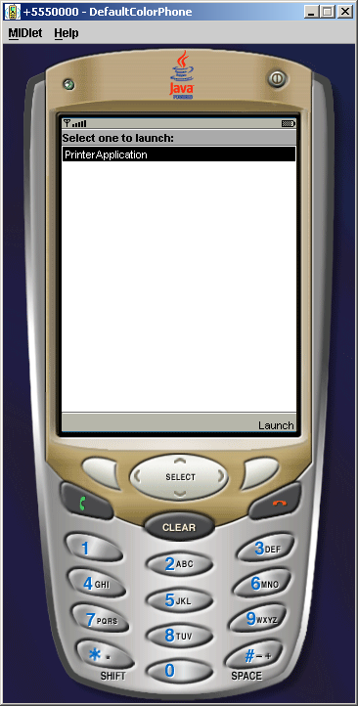
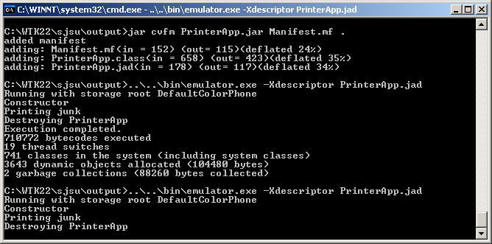

Slide 30
7. Deploy
There are two ways to do this – USB cable or bluetooth via the PCSuite application installer.
To be able to deploy your MIDlet via the Internet, you need to have access to a web server with a real-world IP address or domain name. You also need to have administrative privileges to be able to modify the configuration files of your web server to add some Multipurpose Internet Mail Exchange (MIME) types for the JAD and JAR extensions. If you are using Jakarta/Tomcat as your web server, you don't need to do this, as it already has these MIME types. For the Apache web server, modify the mime.types file and add the following extension types.
text/vnd.sun.j2me.app-descriptor jad
application/java-archive jar
By adding these MIME types, you are informing the browser, or any client accessing these files from the server, how to handle these files when they are downloaded into the device.

Slide 31
7. Deploy
Next, create an HTML file that will become the point of reference. Strictly, this is not necessary, because a device that can access an HTML page can also access a JAD file.
<HTML> Click <a href=“PrinterApp.jad">here</a> to download PrinterApp MIDlet!
</HTML>
MIDlet-Jar-URL: http://www.yourdomain.com/j2me/PrinterApp.jar
Finally, upload the modified JAD file, the newly created HTML file, and the original JAR file to your web server to a directory location where you will be able to navigate to the HTML page via your mobile device browser.

Slide 32
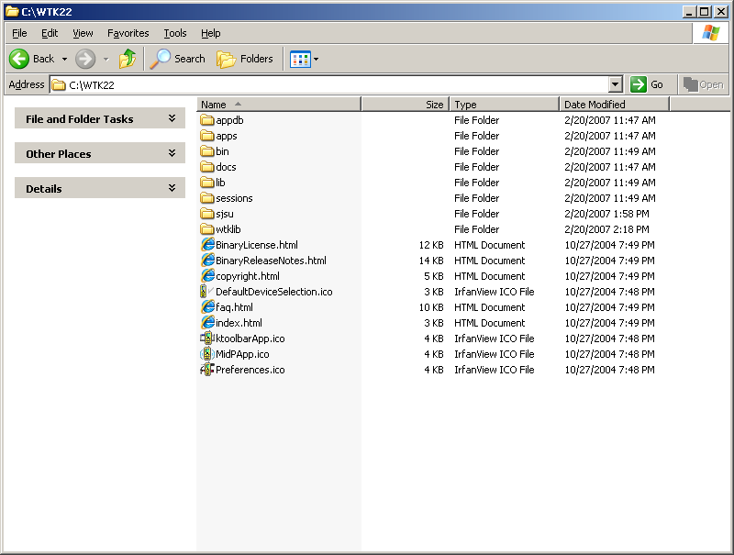
MIDlet Creation via the Toolkit
Wireless toolkit folder contents

Slide 33
Folder Name | Folder Description
appdb | Directory that acts as a simulation for mobile device file system
apps | MIDlets created using the Toolkit reside in this directory
bin | Contains executables for the various tools, including the Toolkit itself, and various other tools like the preverifier and the emulator
docs | The Wireless Toolkit documentation including API documentation for MIDP 2.0 and MIDP 1.1
lib | Contains the JAR files for MIDP (both 2.0 and 1.1), CLDC (both 1.1 and 1.0) and several other optional libraries
sessions | Directory where network and profiling sessions are maintained
wtklib | Contains the libraries for the Toolkit itself, including the properties of various device emulators

Slide 34
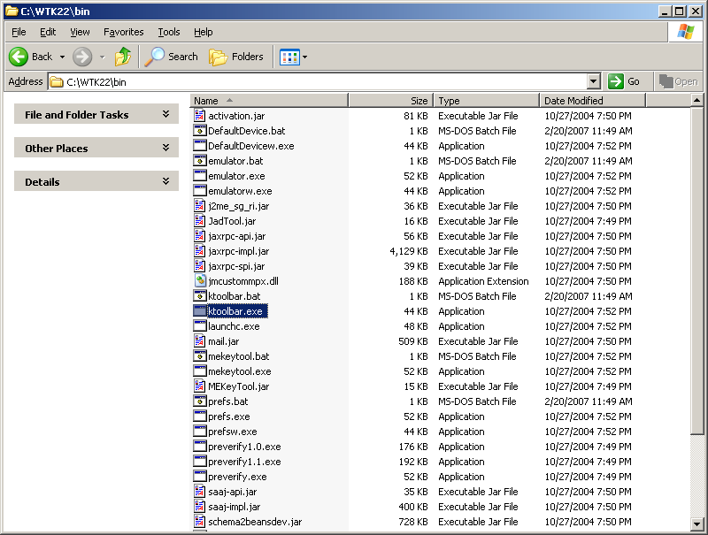
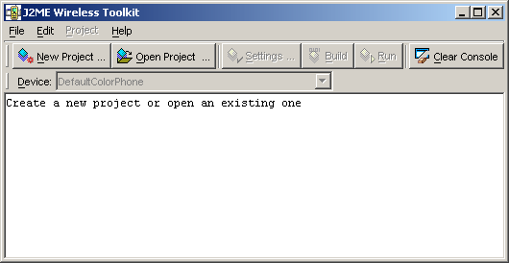
Main Toolkit Window

Slide 35
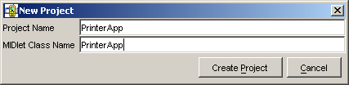
Create a New Project

Slide 36
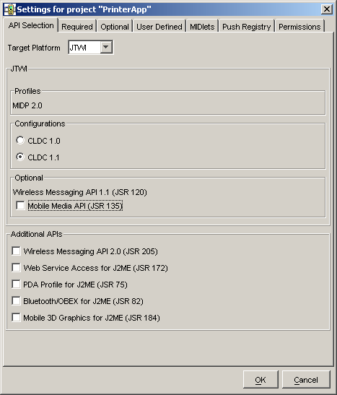
Setting to Control Target Platform

Slide 37
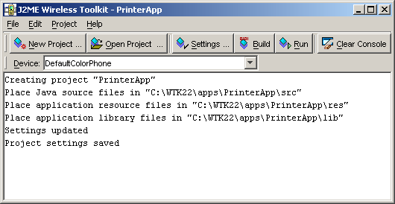
Project Created

Slide 38
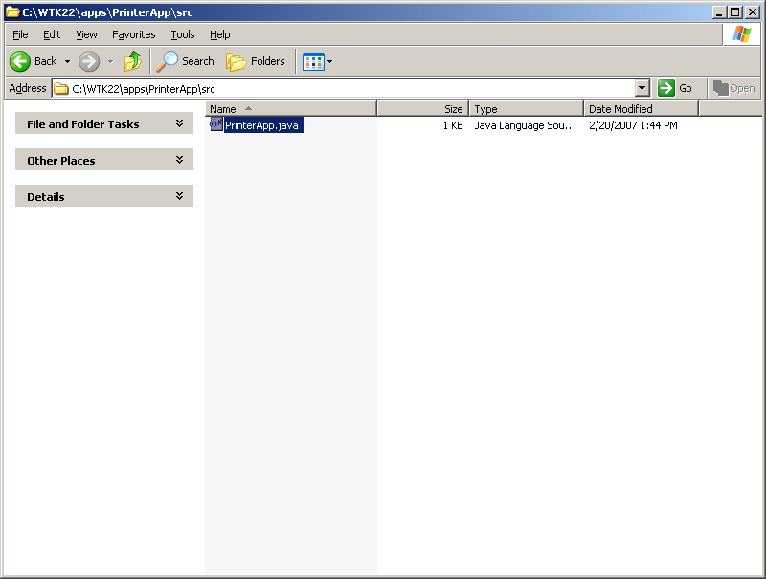
Add Source File

Slide 39

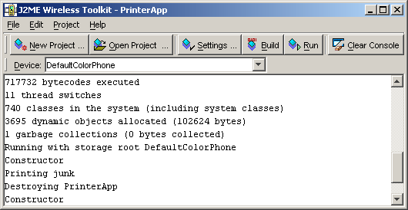
Compile/Building Program
Hit the ‘Run’ Button

Slide 40
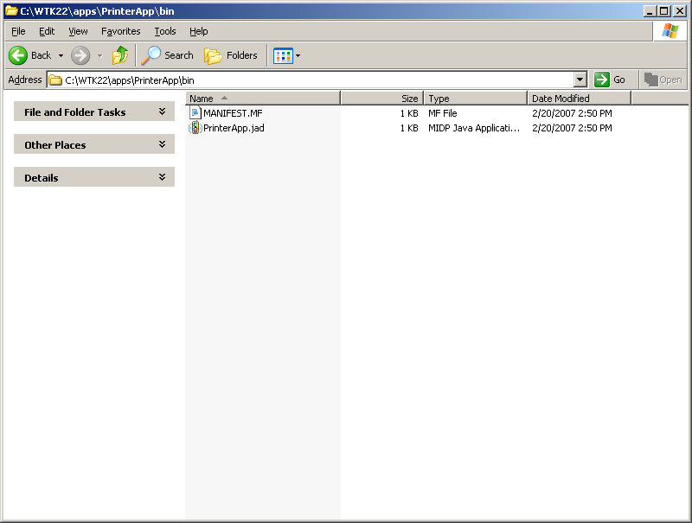
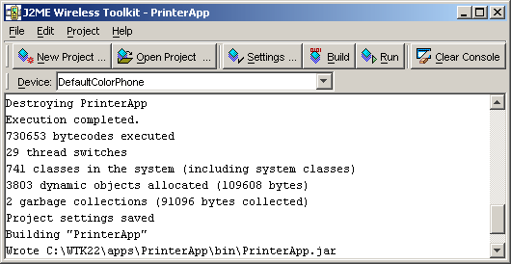
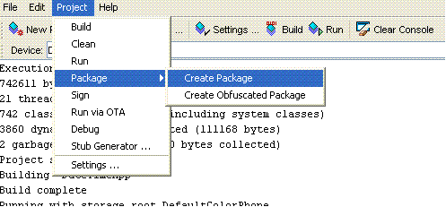
Creating .jar File
Notes:
Running the program will not create the jar file. So go to Project -> Package -> Create package to create a jar file.

Slide 41
Deploying MIDlet over Internet
Package -> Run via OTA (Over The Air)
Creates html file in /bin folder of project.
When you install on your server you need to change the hostname from “localhost” to your host name.

Slide 42
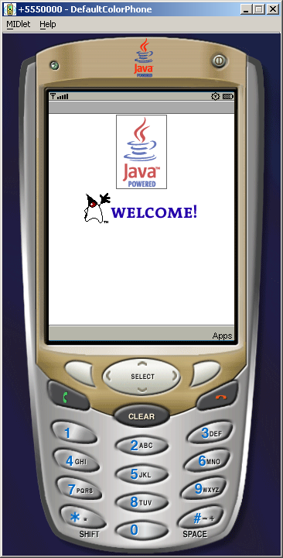
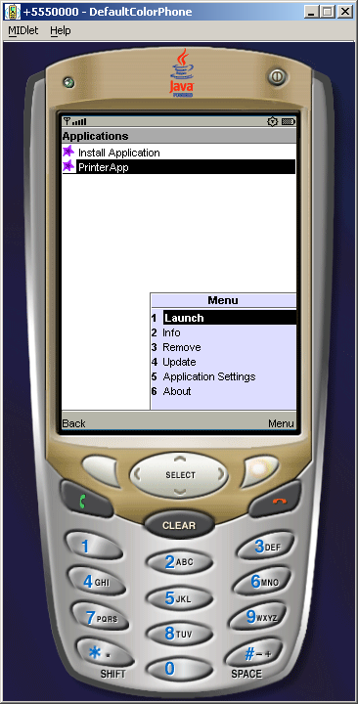

Slide 43
MIDlet Lifecycle
AMS
new(), MIDlets no args contructor
startApp()
MIDlet Paused
MIDlet Active
pauseApp()
destroyApp()
destroyApp()
MIDlet Destroyed
Notes:
AMS -> Application Management Software, MIDlet’s only software

Slide 44
Resources
J2ME Official Website:
http://java.sun.com/javame/index.jsp
Wireless Toolkit
http://java.sun.com/products/sjwtoolkit/
J2ME Books
http://amazon.com/s/ref=nb_ss_gw/105-0179783-9948441?url=search-alias%3Dstripbooks&field-keywords=j2me&Go.x=0&Go.y=0&Go=Go

Slide 45
Assignment
Set-up Wireless toolkit, run a MIDlet on the emulator and transfer to phone.

